Slide 1



Microbial ecology and evolution across salinity barriers and gradients
2025-04-09
Krzysztof T. Jurdzinski
under supervision of
Anders F. Andersson

Slide 2
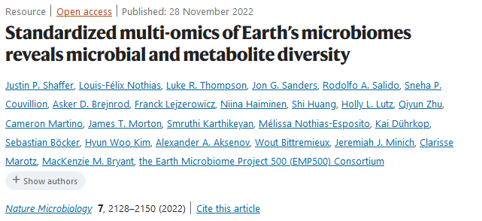
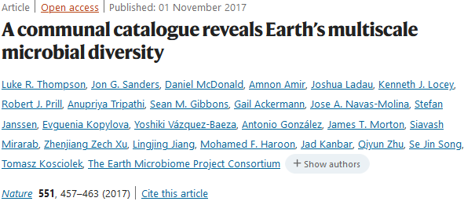
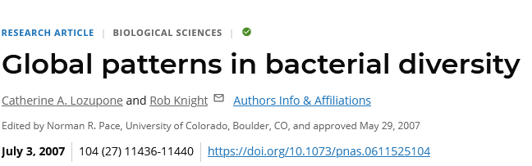
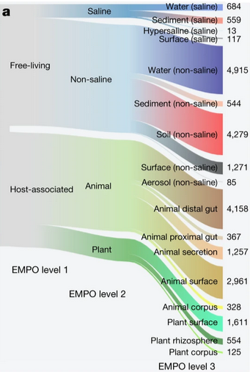
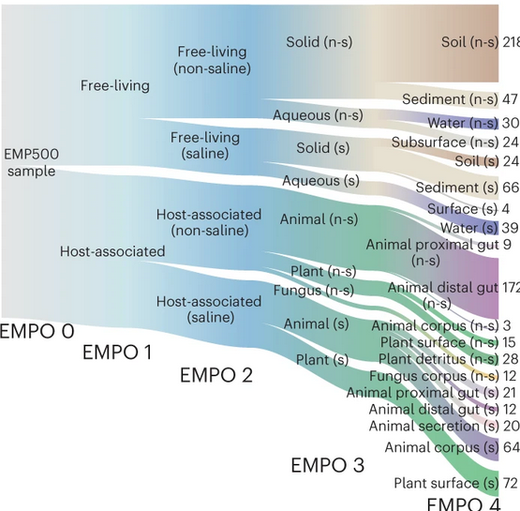
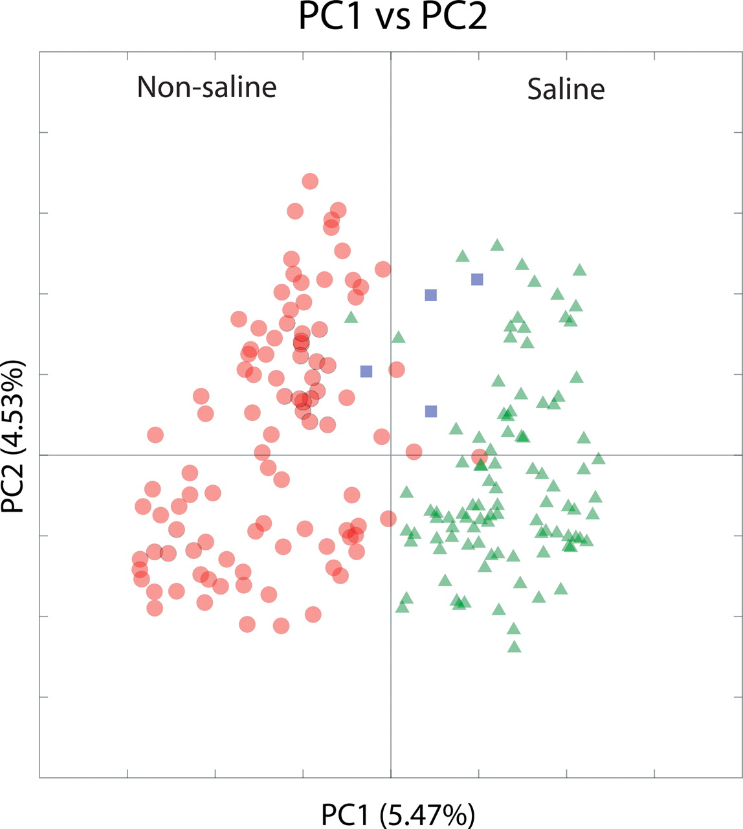
Salinity as the major environmental factor determining the distribution of free-living bacteria

Slide 3
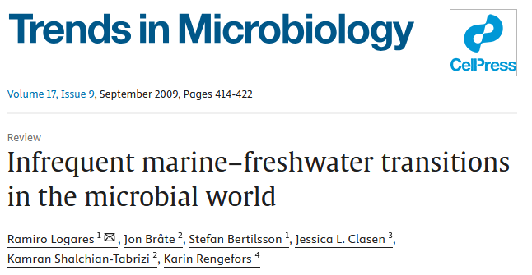

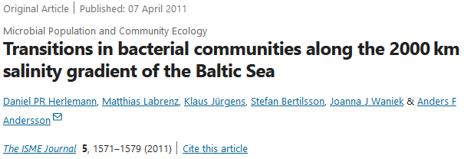
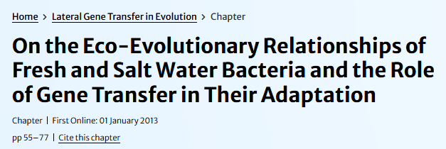
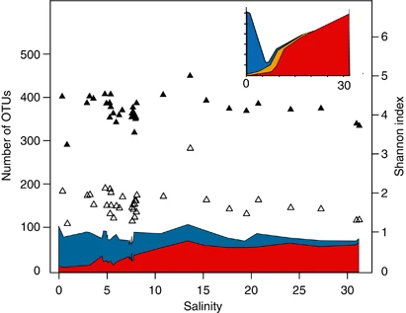
The salinity divide and the biome in-between (or salinity barriers and gradients)
Three aquatic biomes: freshwater, brackish, and marine
Outstanding remaining questions:
How are the bacteria in the three biomes different?
What about protists?
How does salinity affect (alpha-)diversity (number of “species”).
Herlemann et al., 2011
Notes:
Sodium motive-force
Remember about the brackish volume!

Slide 4

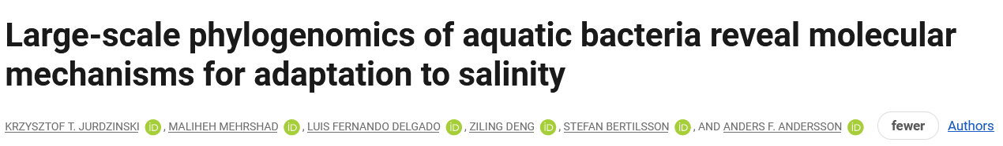
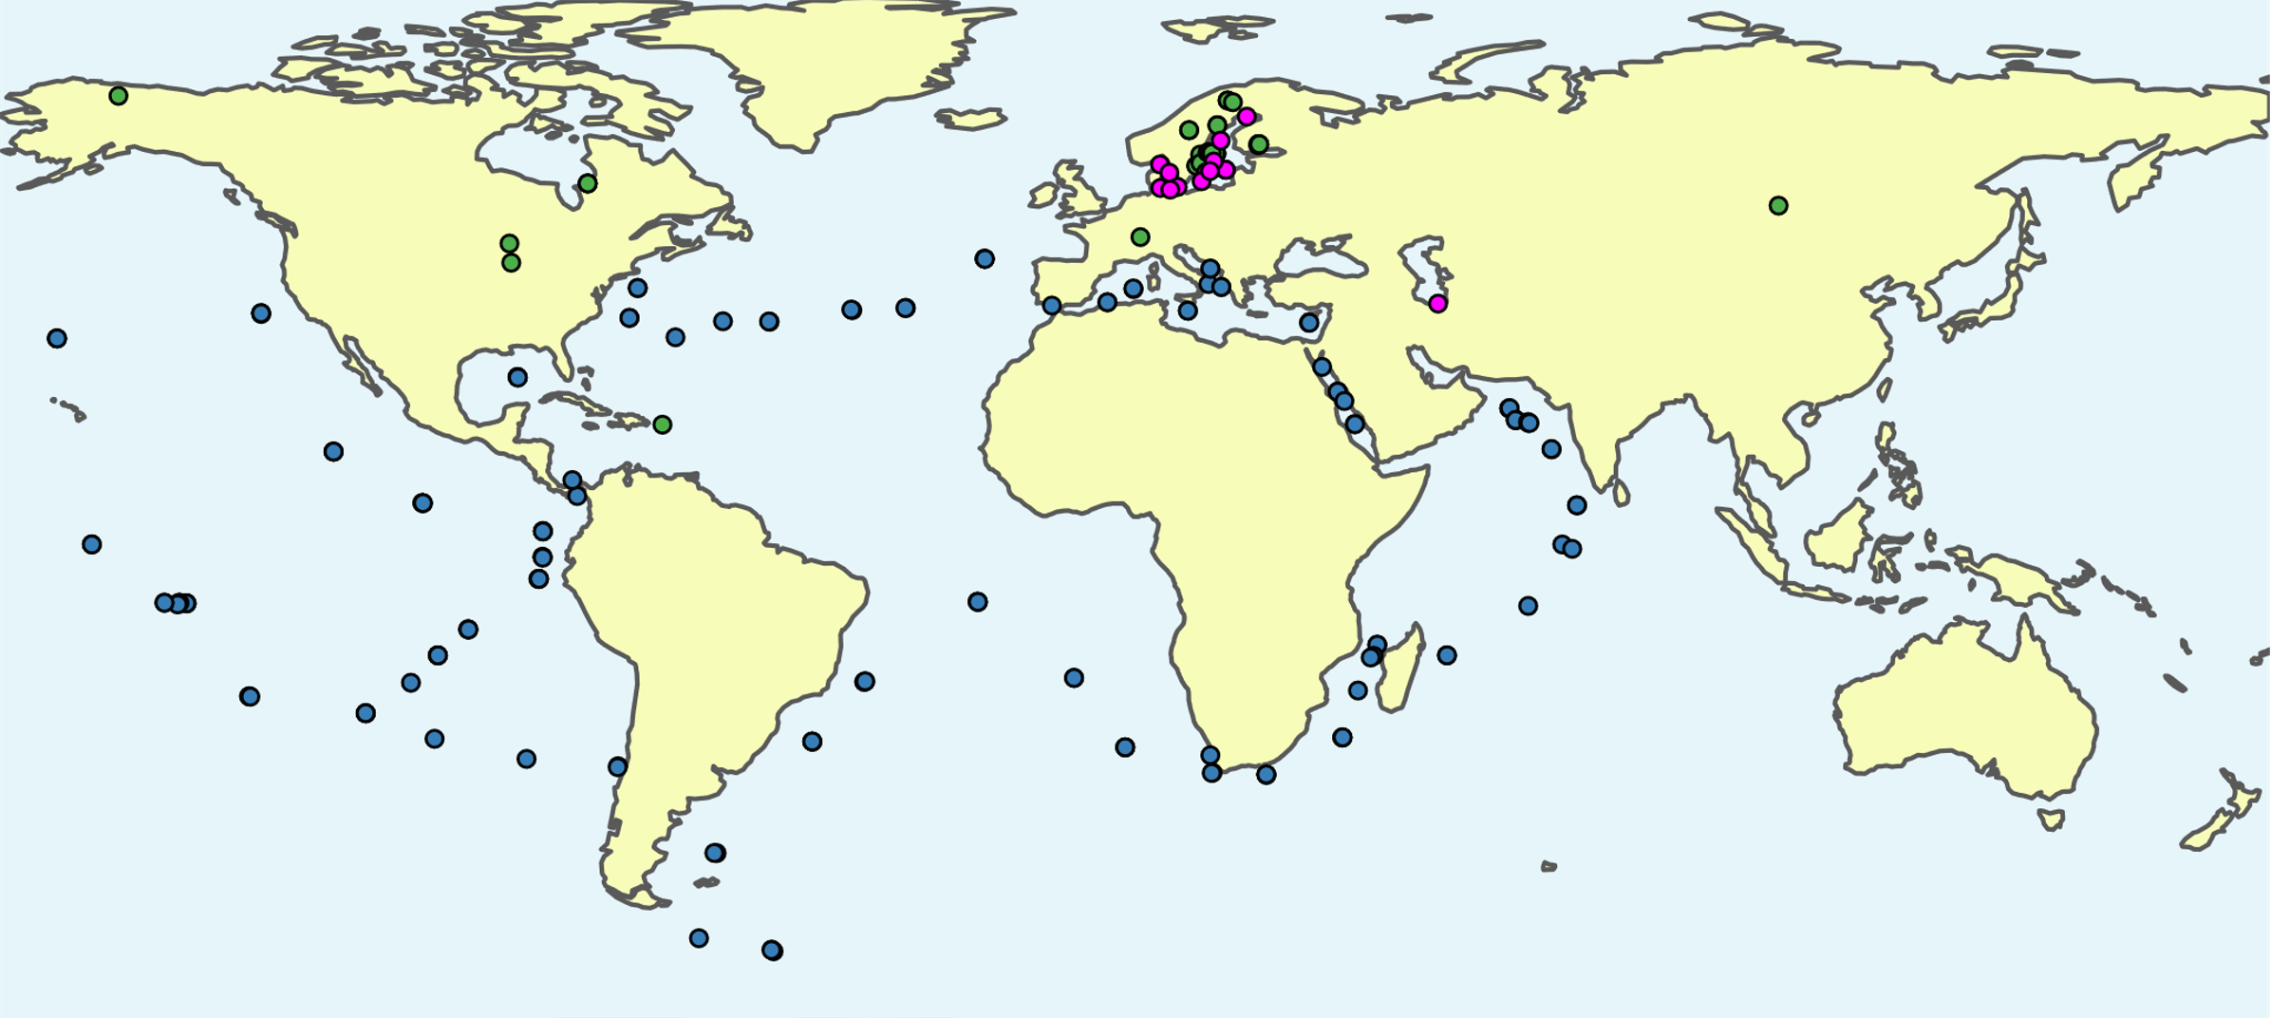
Linz et al. (2018)
Buck et al. (2021)
Cabello-Yeves et.al. (2018)
Alneberg et al. (2020)
Mehrshad et al. (2016)
Tully et al. (2018)
Delmont et al. (2017)
Metagenomes: 416 freshwater, 126 brackish, 243 marine
11,276 MAGs; 3575 ~species: 2073 freshwater, 498 brackish, 1004 marine

Slide 5
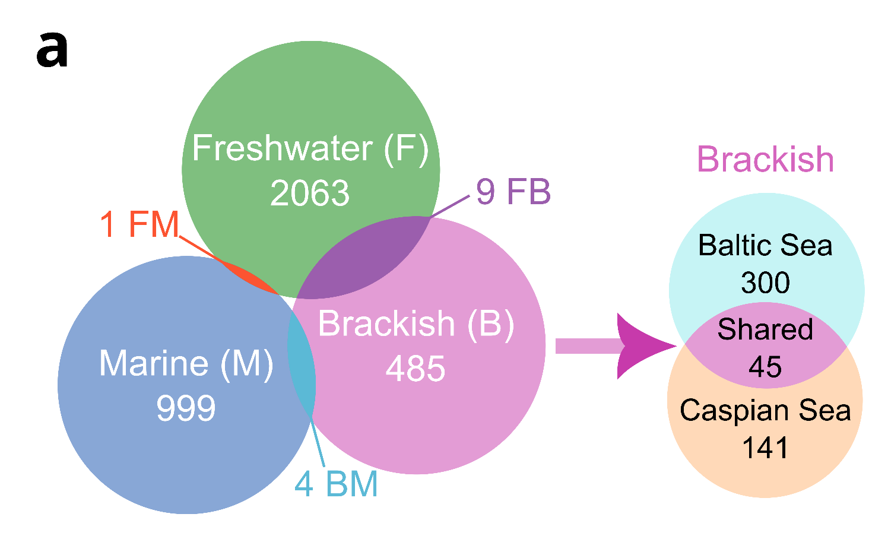
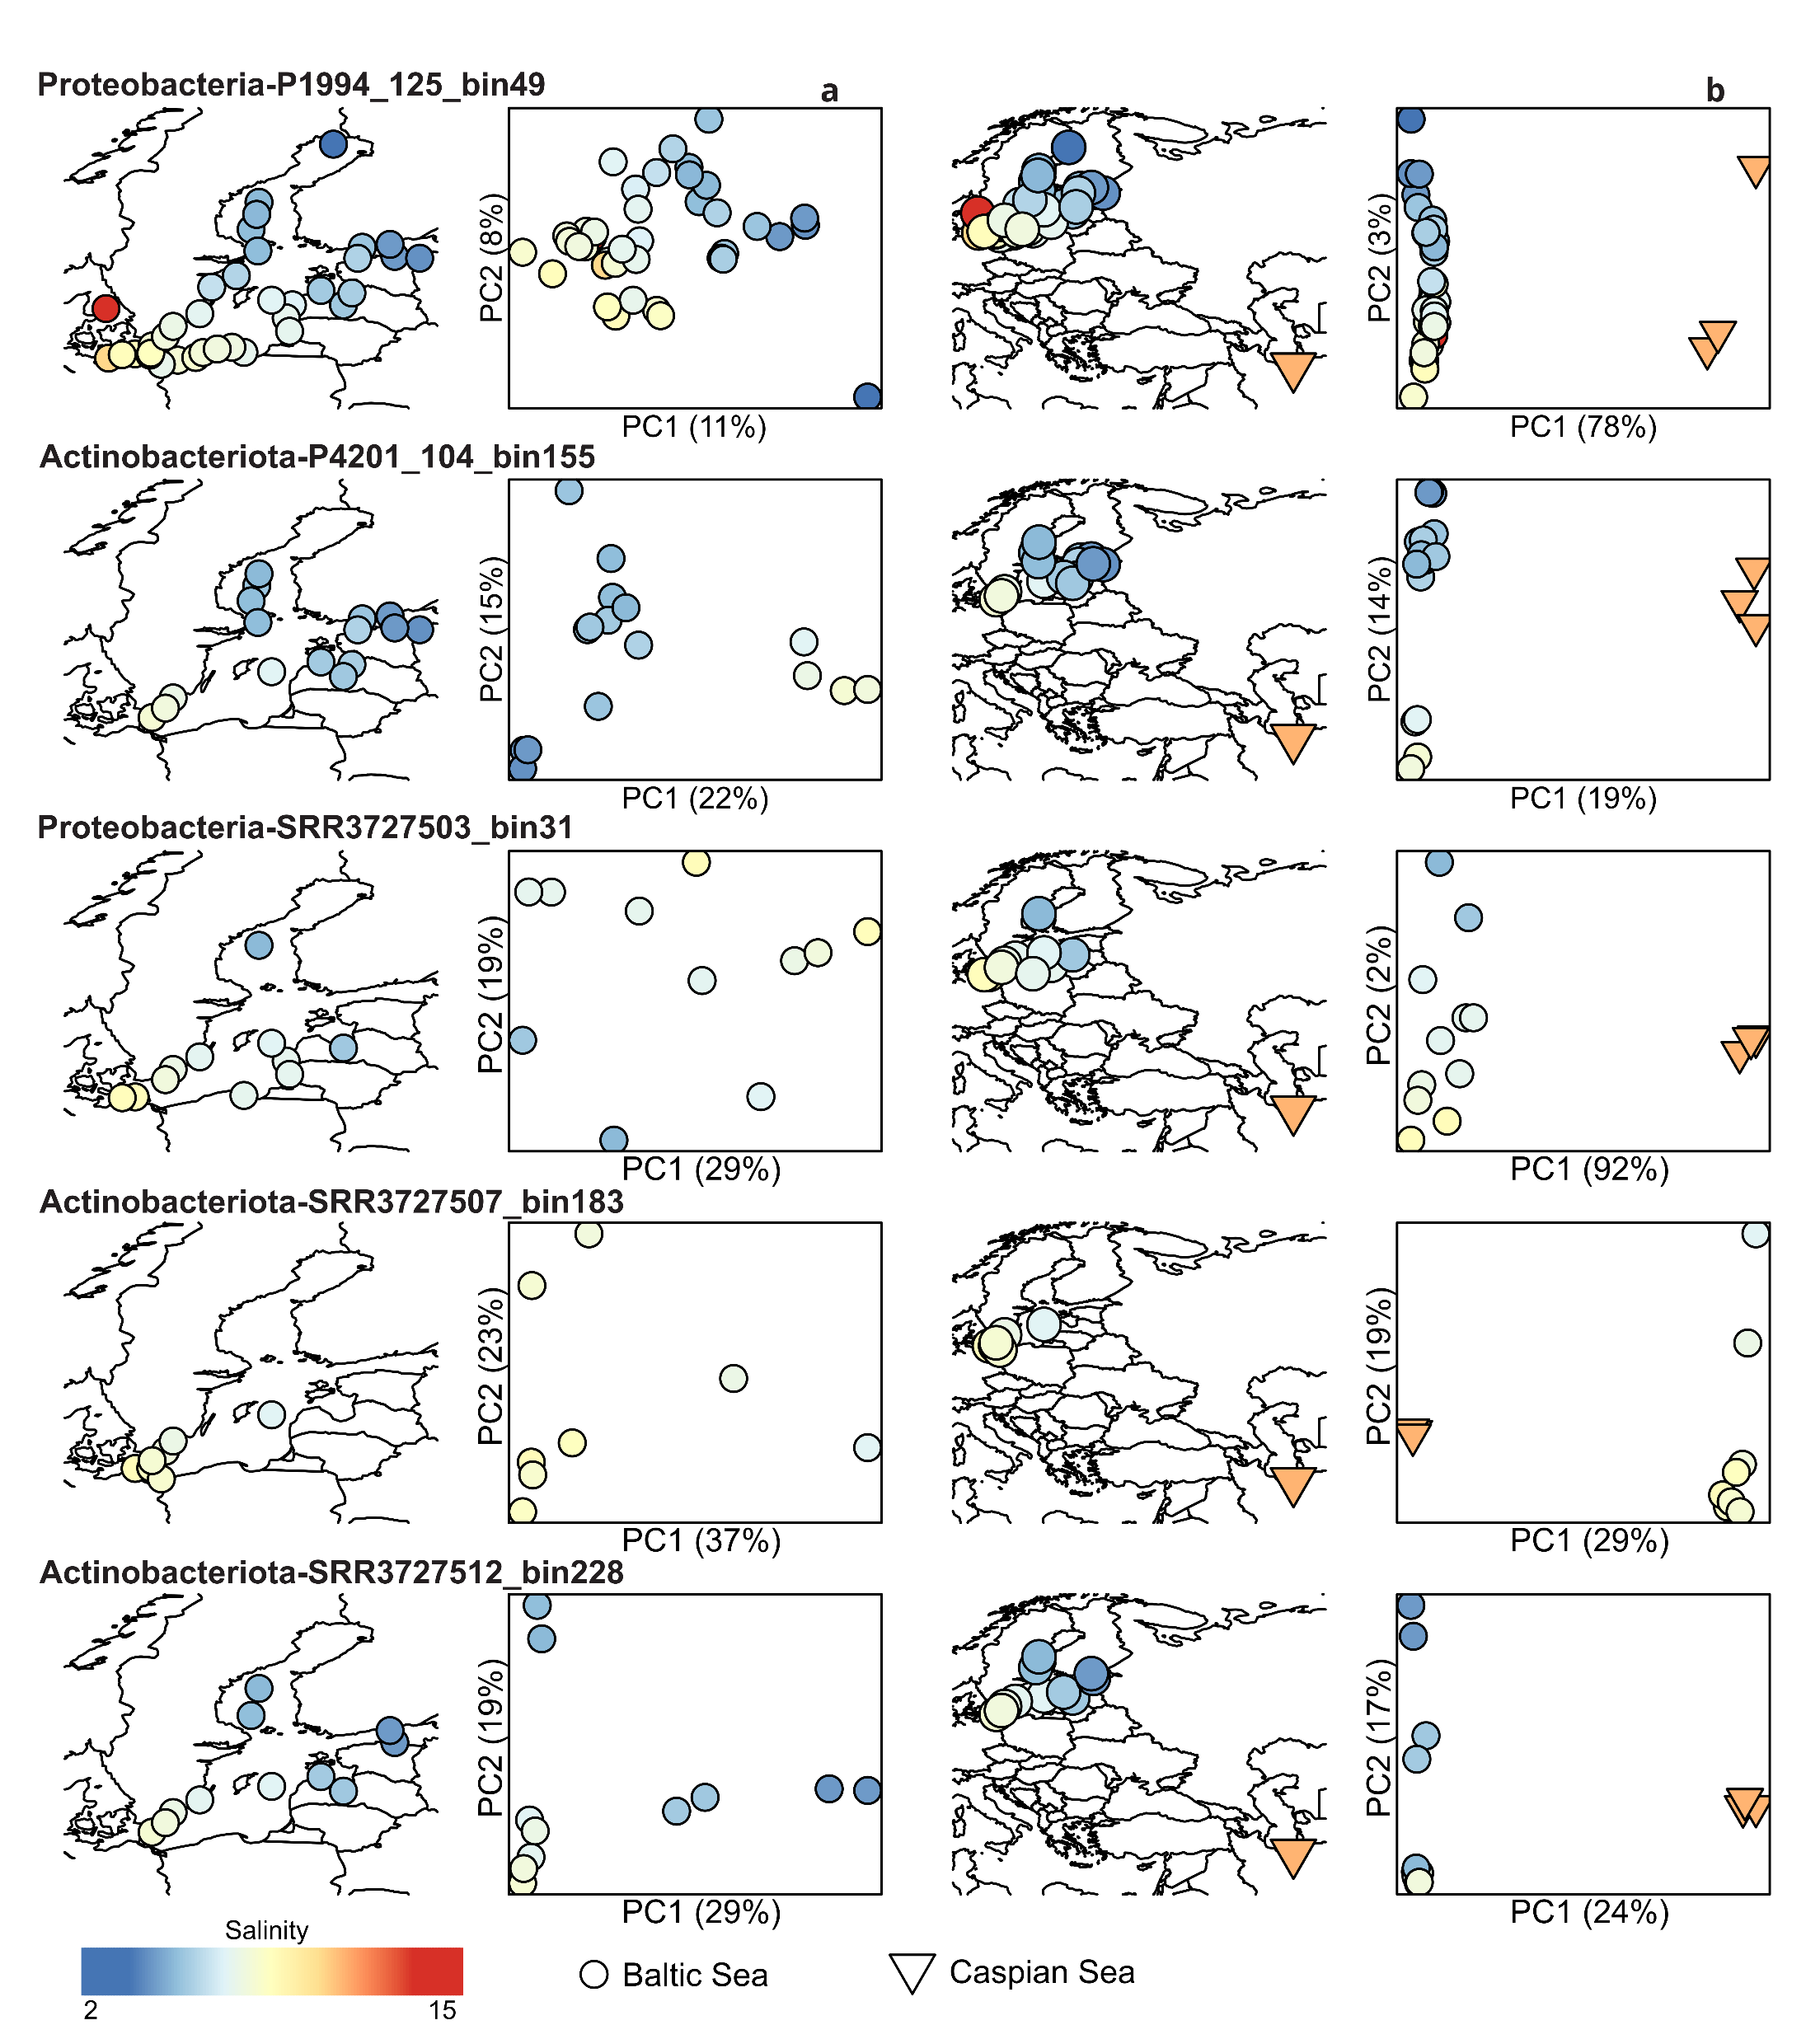
Species-level separation between biomes
Geographic micro diversity within the brackish biome
Species-level separation between biomes

Slide 6
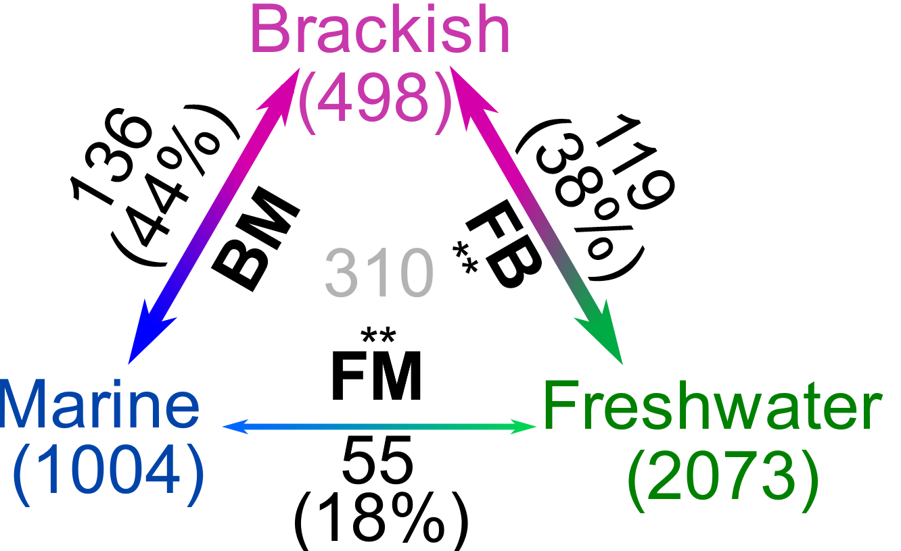
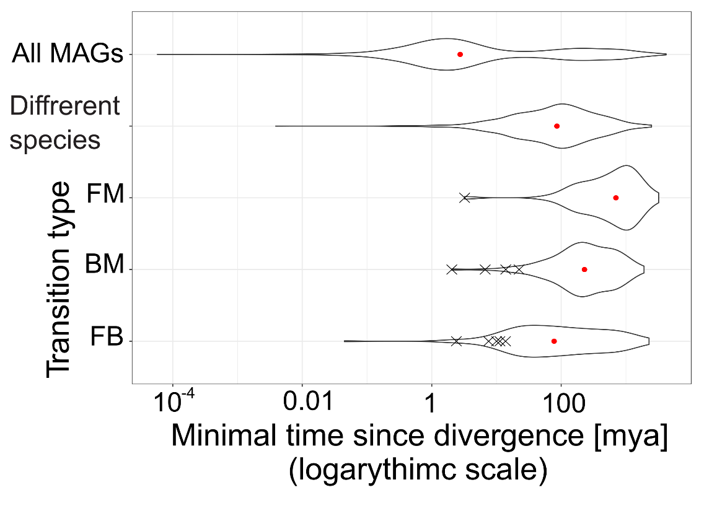
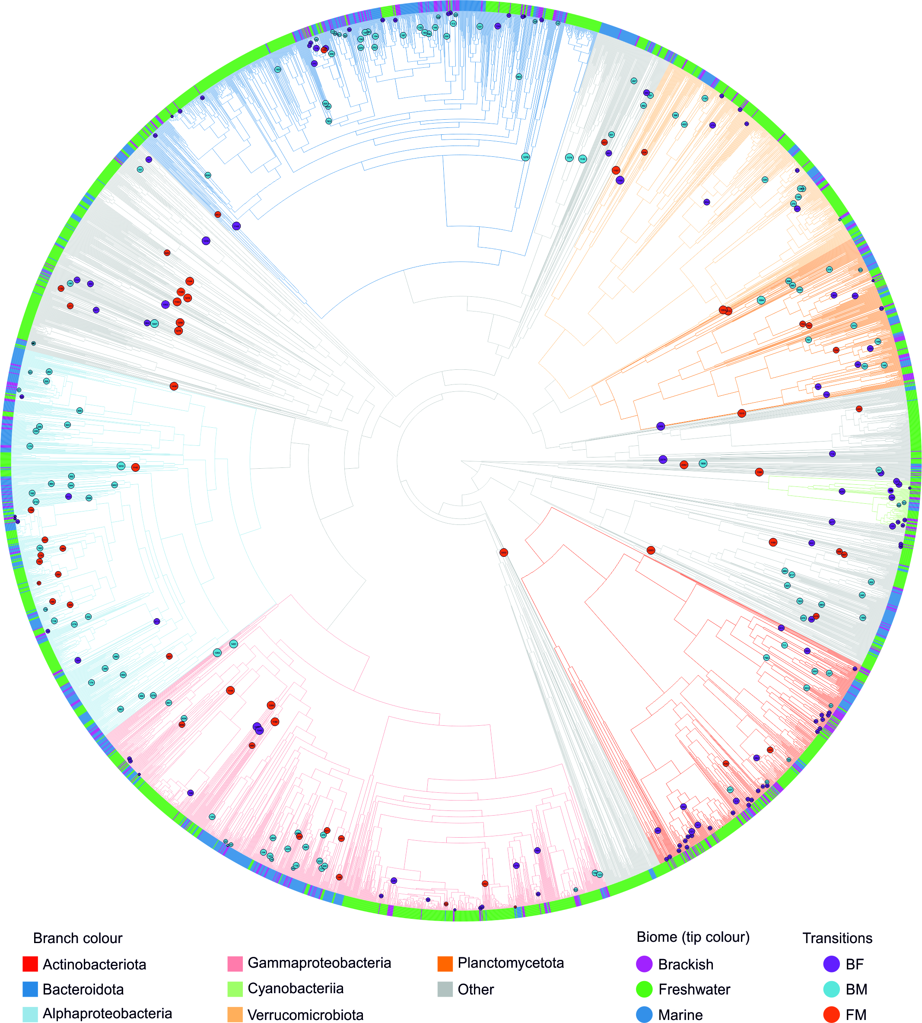
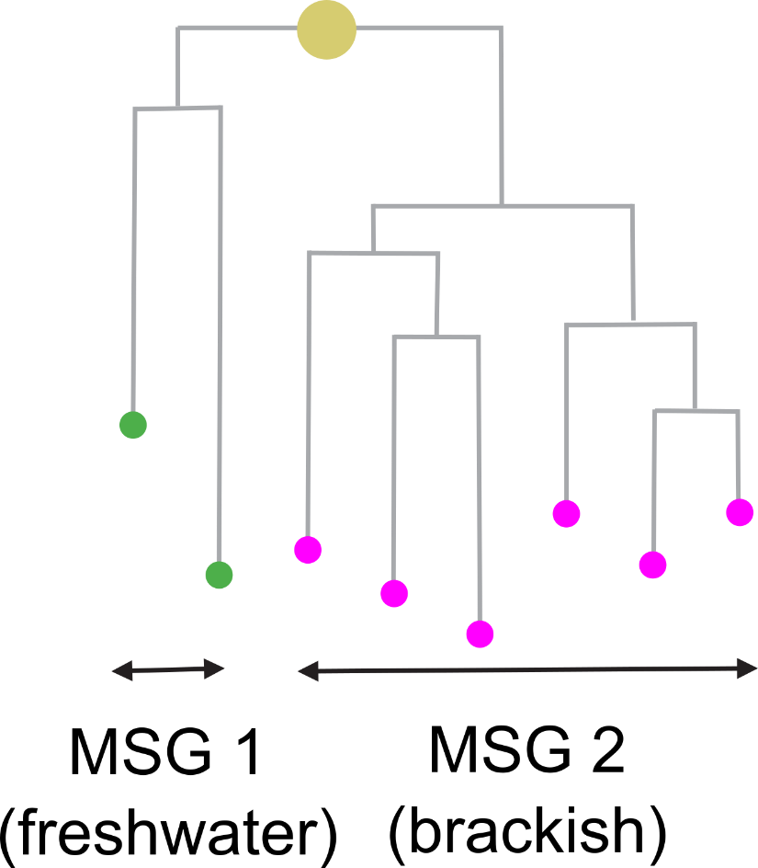
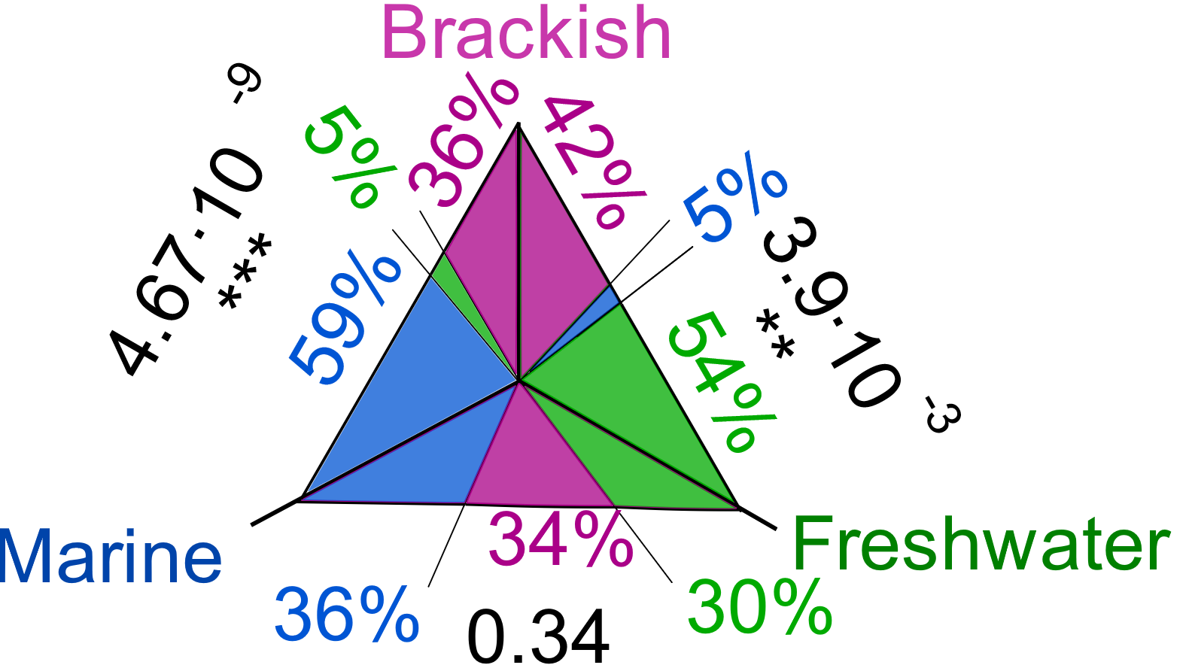
Cross-biome transitions were rare, ancient and more often into than out of the brackish biome
Transitions as pairs of monobiomic sister groups (MSGs)
Age of: Baltic Sea Caspian Sea
8 kya
2-3 mya
E.g
Niches filled by migration not adaptation

Slide 7
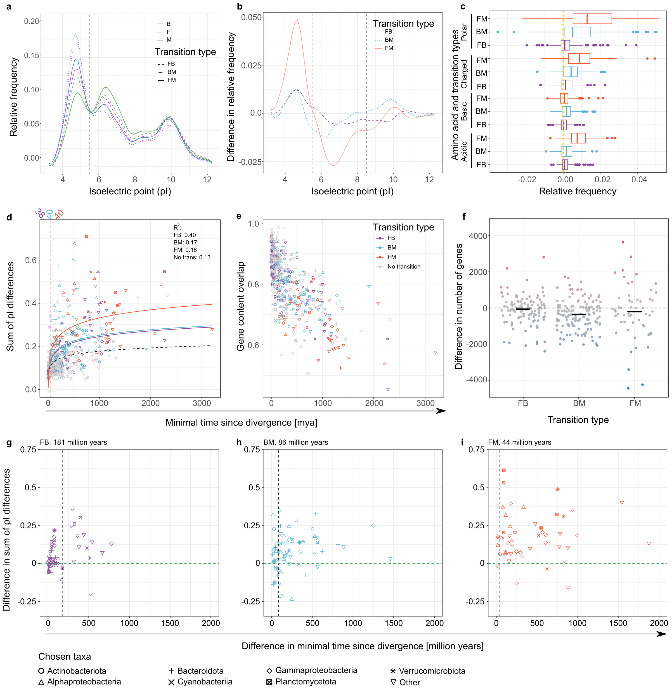


Wide-scale changes in proteome properties are driven by differences in the frequency of acidic amino acids
Inspired by Cabello-Yeves and Rodriguez-Valera (2019)

Slide 8
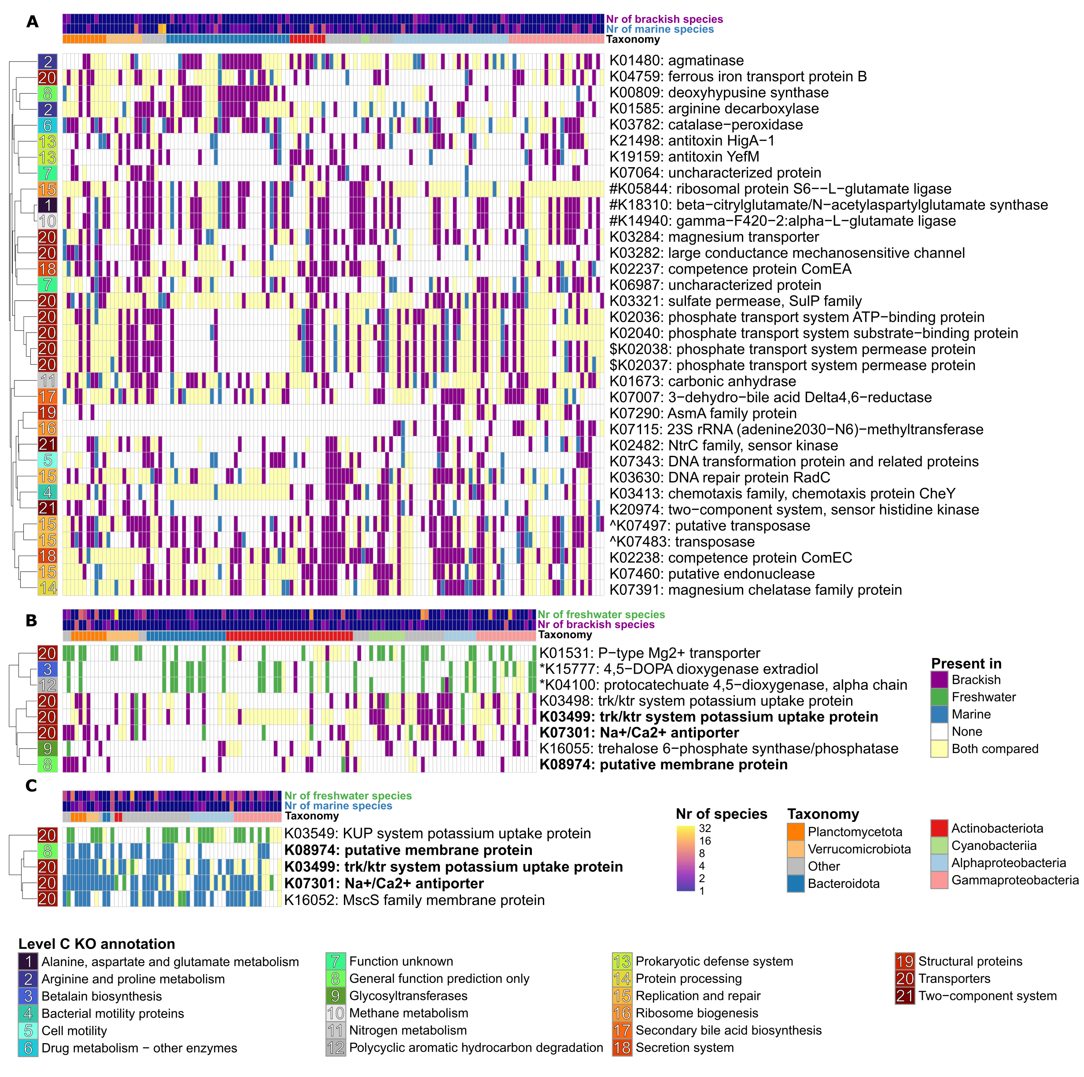
Gains and/or losses of the same functional genes allow diverse bacteria to transition between biomes
Freshwater ↔ Brackish
Marine ↔ Brackish
Freshwater ↔ Marine
Some “obvious”, e.g. K+ uptake systems,
Na+-coupled transport
Not discussed before but (potentially) directly connected e.g. Mg2+ uptake,
chemotaxis
More complex and/or cryptic e.g. modifications of charged amino acids
transposases, antitoxins, and competence proteins

Slide 9
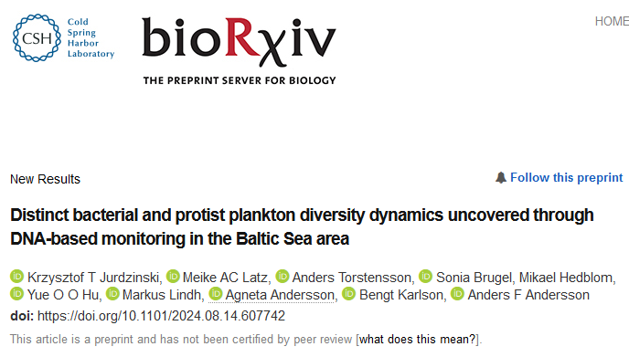
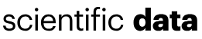
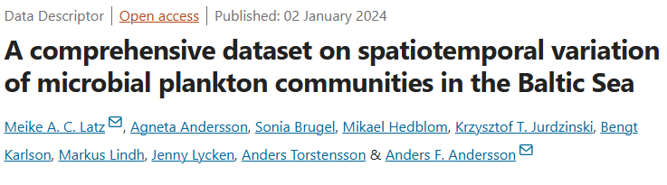
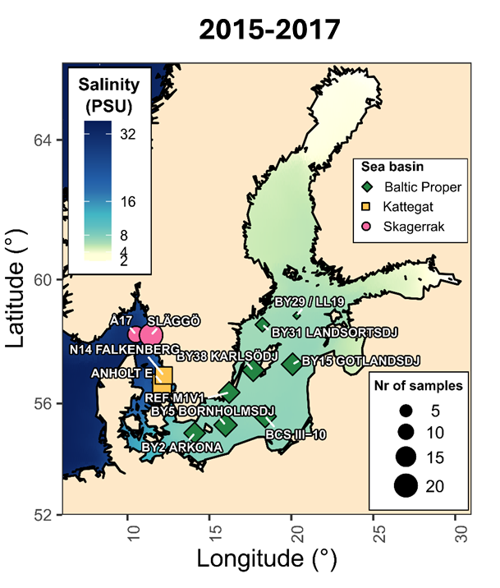
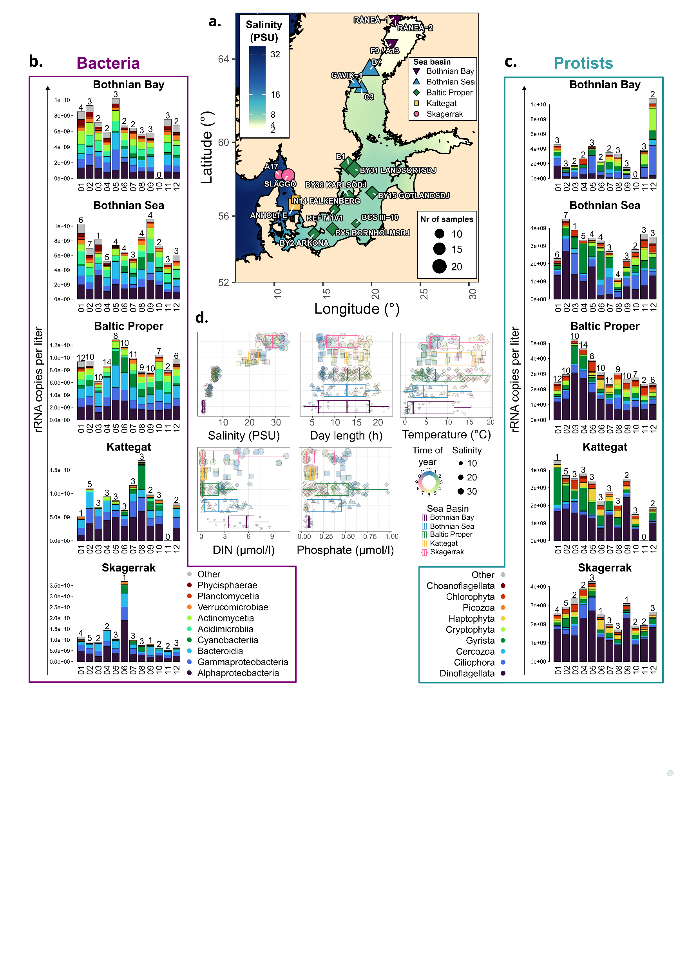
2019-2020

Slide 10
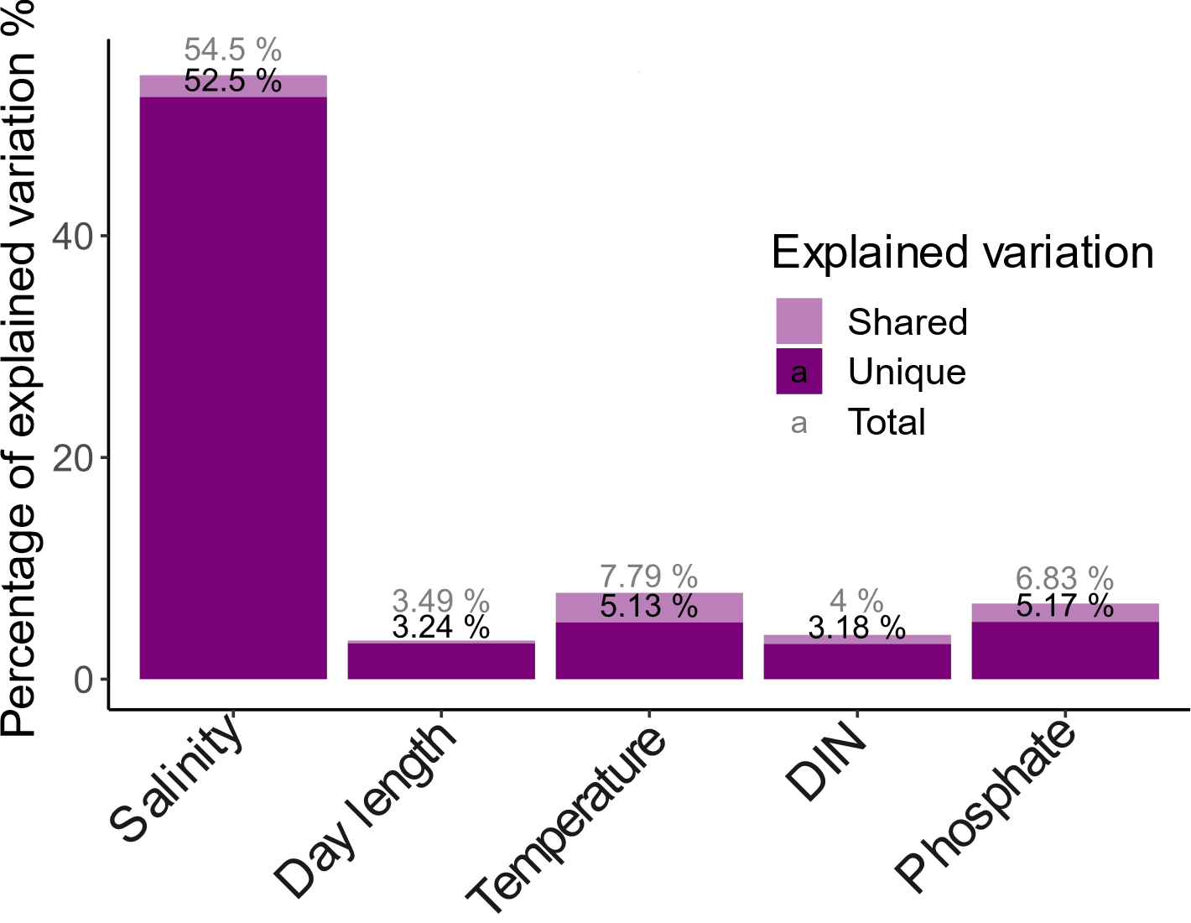
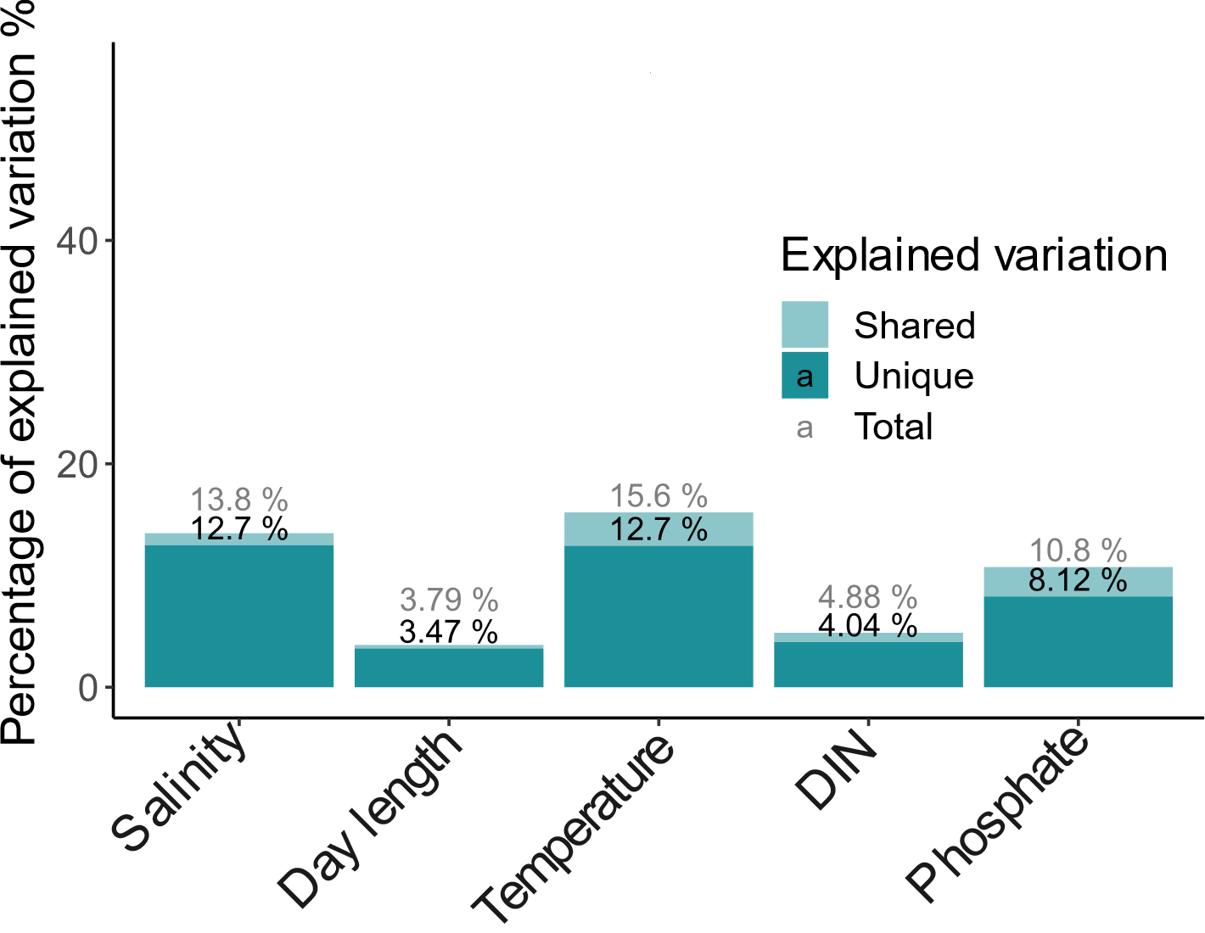
Salinity has a dominant impact on bacterial but not protist community composition
Bacteria
Protists
Notes:
The first thing we look at is beta diversity. How similar are the microbial communities across space in time in the Baltic Sea area? It turns out that, consistent with previous results, bacteria largely follow salinity. However, salinity has a much lower impact on protist communities, despite other factors being at least as influencial as for bacteria.
I will come back to beta diversity more in detail in a moment…

Slide 11
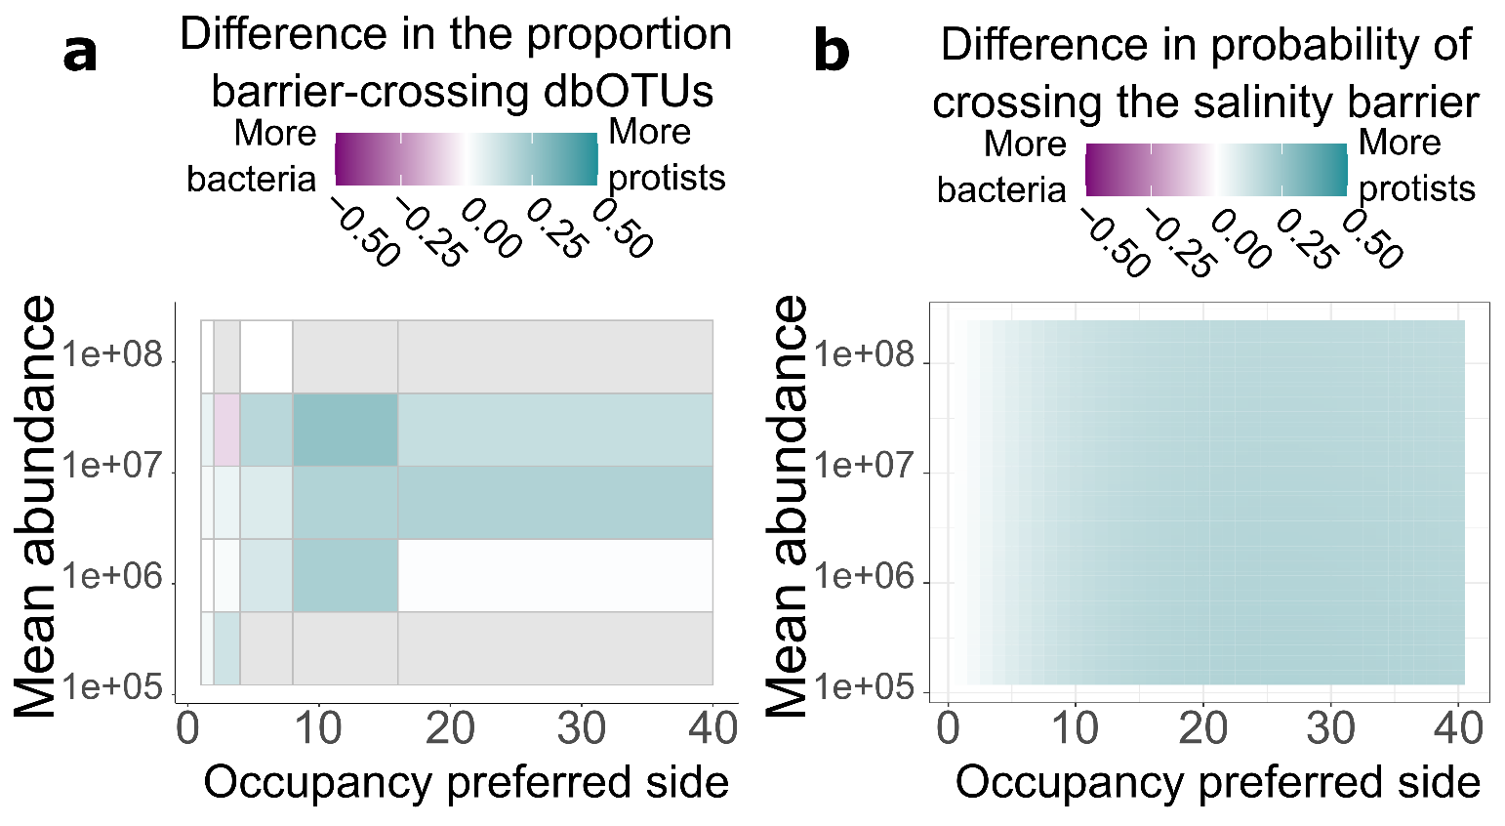
Protist more often cross the salinity barrier
Notes:
So, across the salinity barrier between the Baltic Sea and the Kattegat-Skagerrak, we have seen bigger changes in beta diversity for bacteria, but across the same barrier, protist alpha diversity changed more. Does that mean that abundant bacteria and rare protists are the groups most affected by salinity? Not at all! Across abundance and occupancy values, it was protists that were more likely to cross the salinity barrier, both based on raw data and a Bayesian model. Therefore, both in terms of community composition and the present taxa, salinity affected bacteria more than protists. The remaining question is…

Slide 12
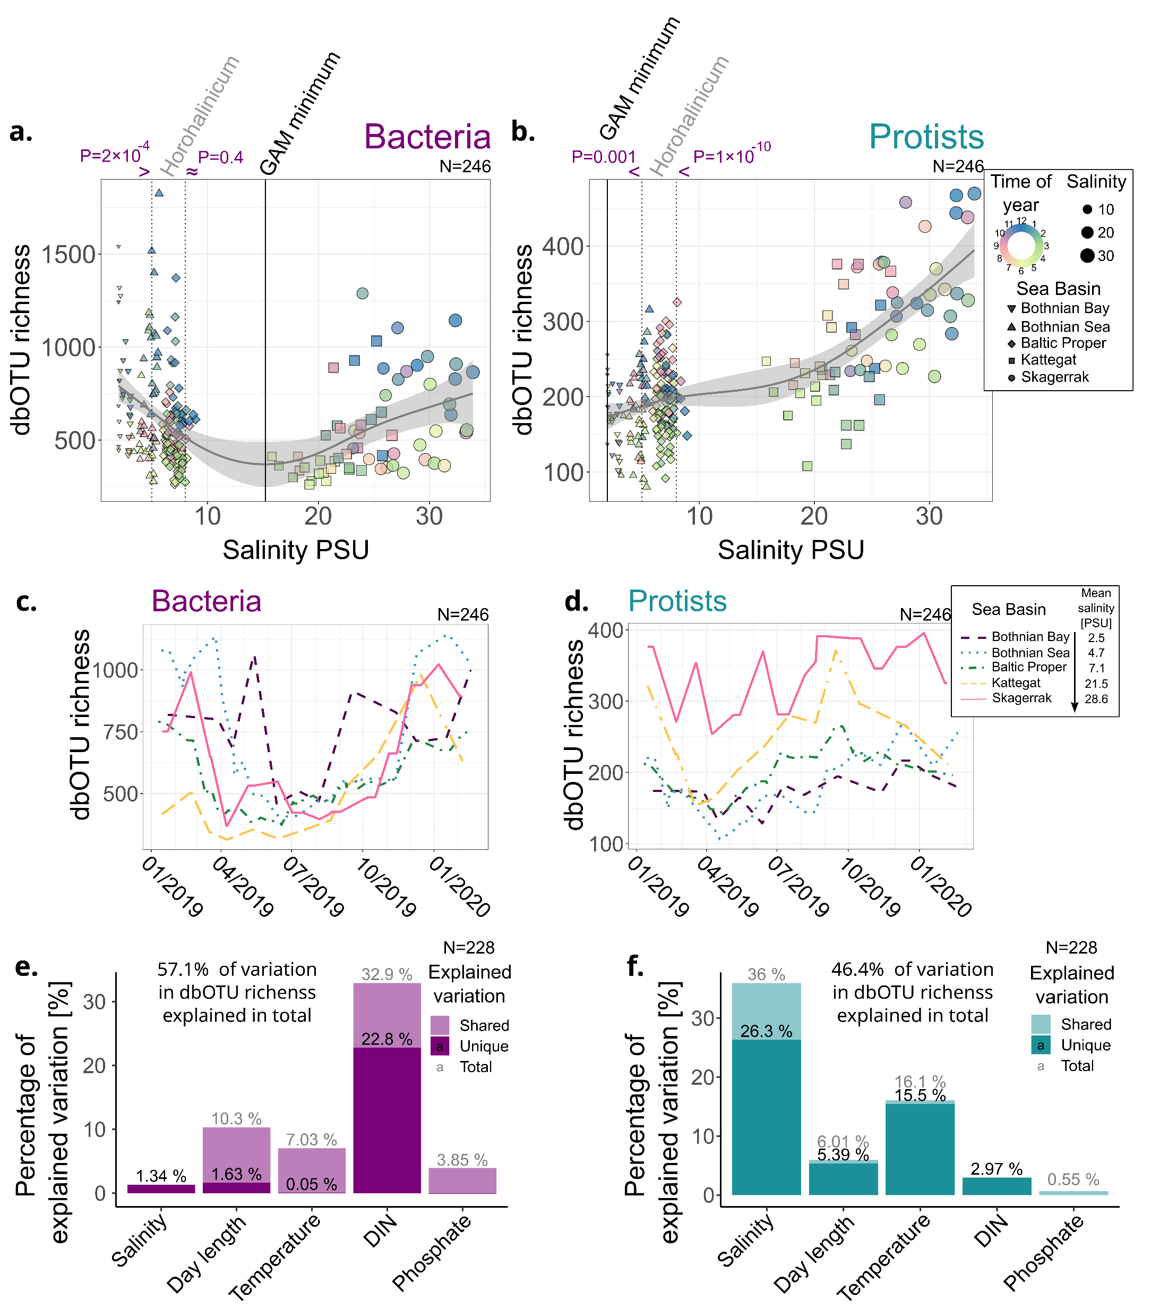
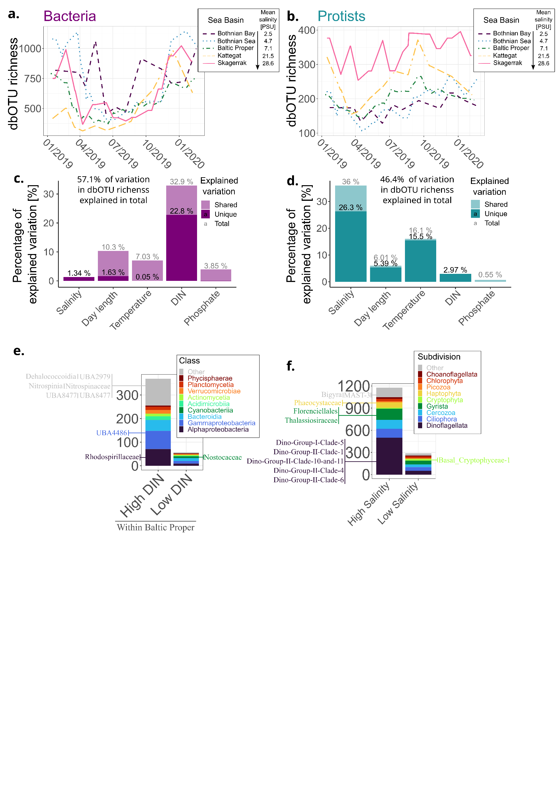
Bacterial alpha-diversity follows primarily seasonal patterns…
Notes:
Now that allows us to move into alpha diversity. How many lowest-level taxa – called dbOTUs in this case – could we find in a sample? For bacteria, if we just run linear correlation, dissolved inorganic nitrogen by far correlated best with alpha diversity. And we can see that this corresponded to seasonal variation rather than stable differences between the regions (so, each line on this graph is a rolling mean for a region). But was DIN really causing this seasonal vartiation?

Slide 13
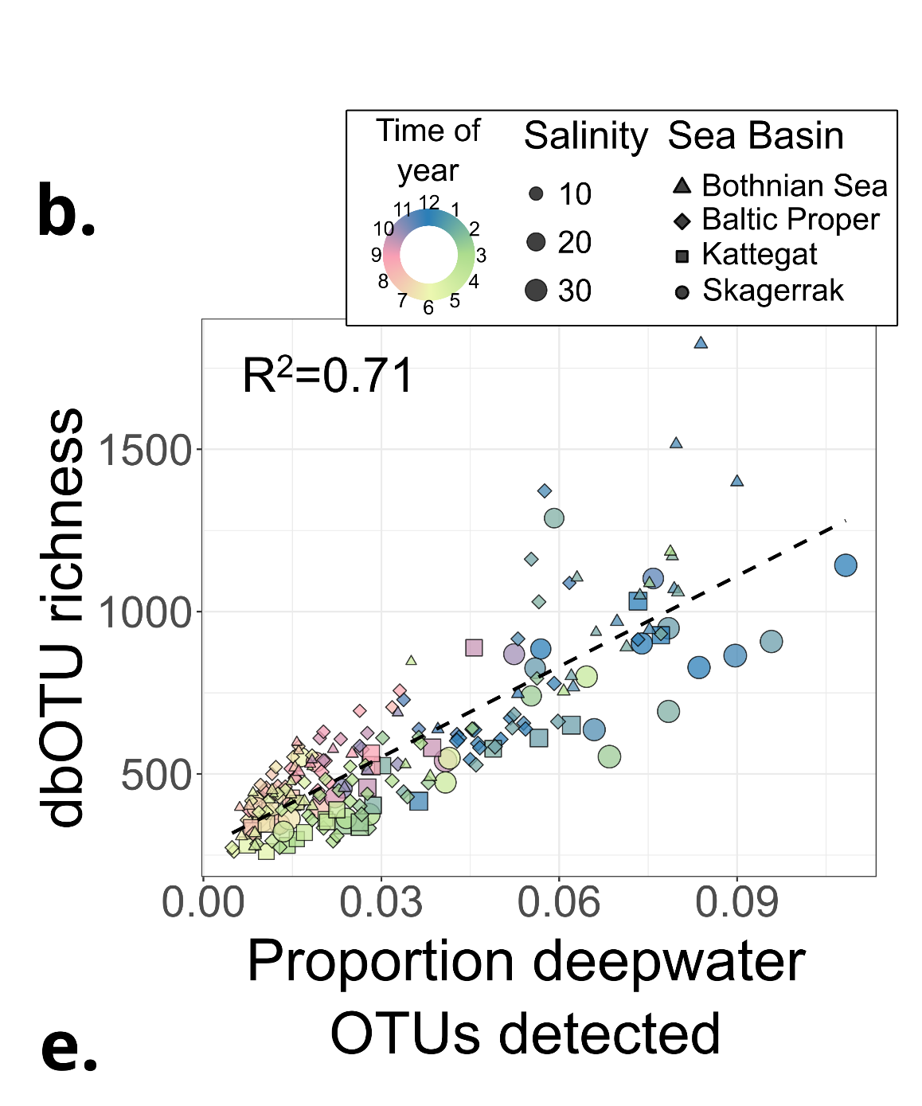
…which can be explained by convective vertical mixing in winter
Using data from Herlemann et al. 2016
Notes:
A well-discussed confounding factor would be convective mixing, the idea being that it brings extra taxa to the surface from deeper waters. To test that, we used data from yet another previous paper, where they did winter and summer transects with depth profiling. And what we get is that the proportion of deepwater taxa from the previous study found in our surface water samples correlates with alpha diversity much better than any of the physicochemical factors we assessed. What is more, once we correct for the presence of deepwater taxa, the DIN no longer associates with bacterial alpha diversity.

Slide 14
Protists are more diverse in near-marine salinities
Notes:
What about protists? Here, the main pattern was geographic and followed the salinity gradient, with the most saline Kattegat and Skagerrak also being the most diverse regions. Now, this is analogous to the diversity patterns for many animal groups, and we propose an analogous explanation. That is, many marine species adapted to the environment in Kattegat-Skagerrak but fewer to the conditions further down along the salinity gradient in the Baltic Sea. At the same time, the number of adapting marine species was larger than that of freshwater species. Whether this is actually the case, further research will show.

Slide 15
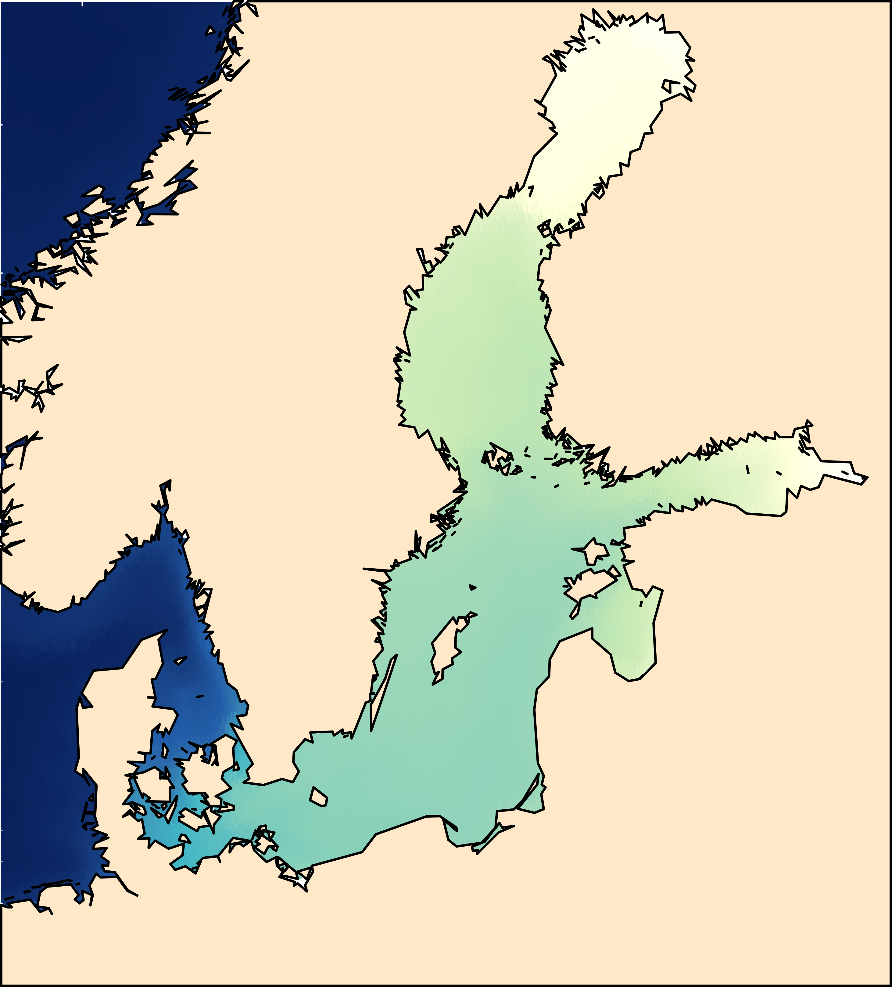
Protists are more diverse in near-marine salinities

Slide 16
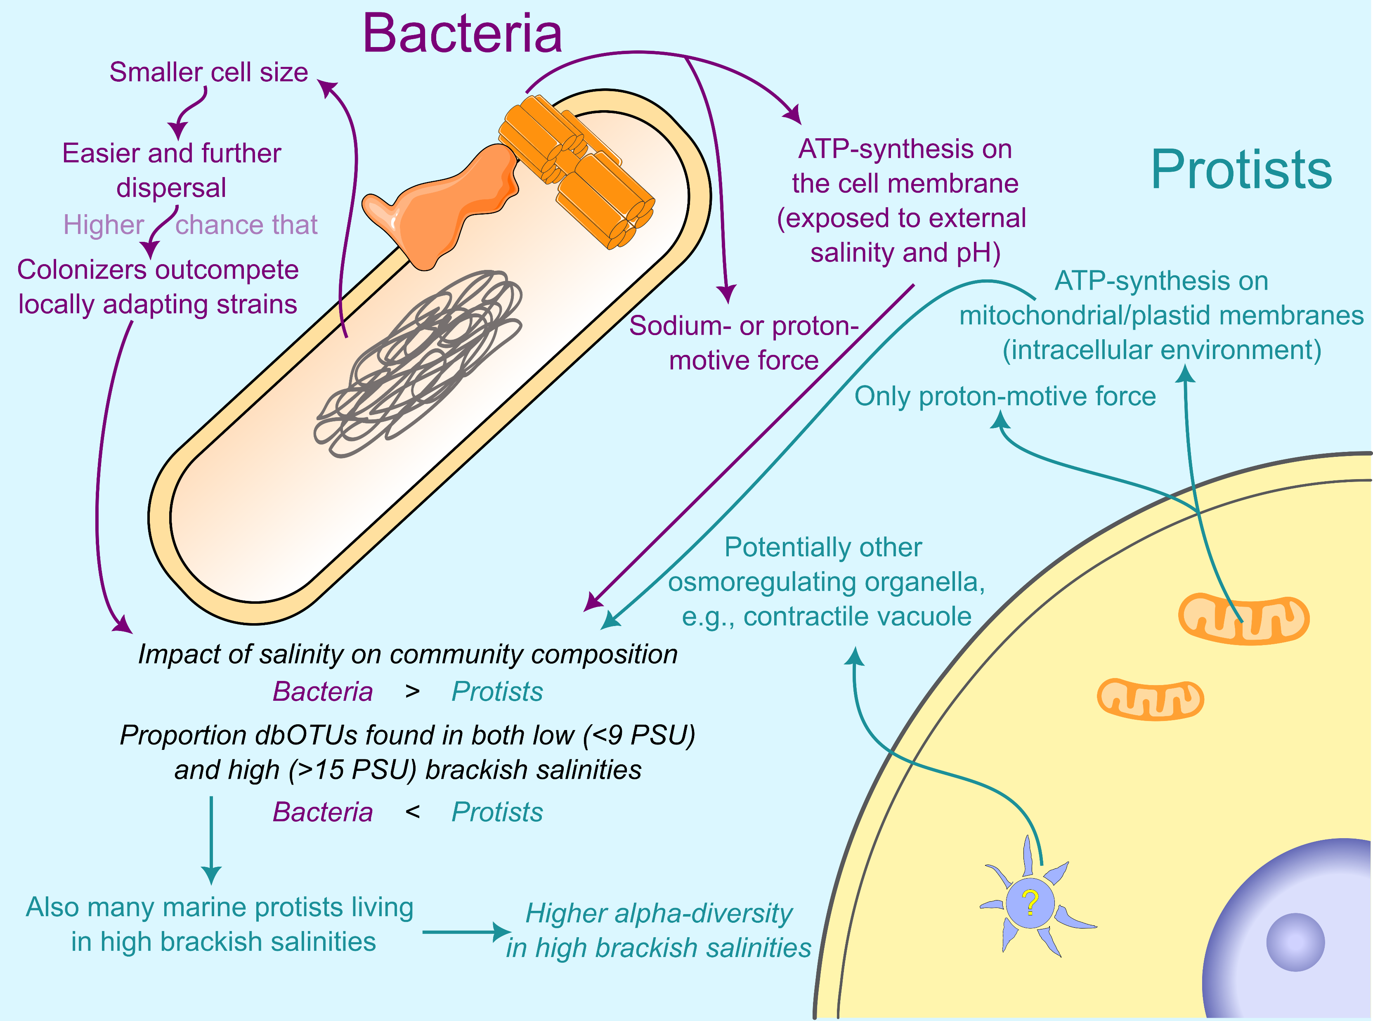
Proposed explanation for protists being ecologically less sensitive to salinity
Further and more frequent dispersal (for bacteria)
Compartmentalization
Colonizers more likely to
outcompete locally
adapting strains
Basic bioenergetic processes disconnected from the cell membrane
Notes:
Why? While there is a long way to well-grounded explanation, we propose plausible potential mechanisms. One idea is that compartmentalization makes adaptation to a different salinity easier for protists. Bacteria have much of their bioenergetics, especially the generation of the proton or sodium gradient for ATP production, happening at their outer membrane. This is a complex system strongly affected by salinity, and adaptation of it would pose a major challenge. Analogous processes in the eukaryotic cell happen across internal membranes and are not much affected by the external environment. In addition, bacteria have been shown to disperse further and more frequently, which is consistent with them just being smaller as per particulate physics. That would mean that after the salinity changes in an environment, local bacterial strains stand little chance to adapt, as they are likely to be outcompeted by colonizers already adapted to the new conditions. Now whether these explanations stand scrutiny is yet to be shown, and we propose some ways to test them in our…

Slide 17
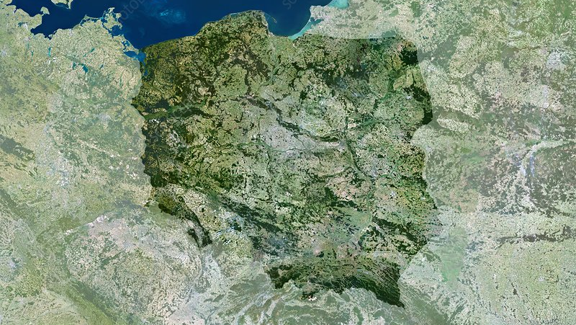
The Baltic Sea
Brackish;
Pronounced salinity gradient;
Geologically recent (8kya);
Early anthropogenic pressures.
Salt deposits
in coal mines
Permanent salination of some streams;
2022 Odra River catastrophe (Prymnesium parvum)

Slide 18







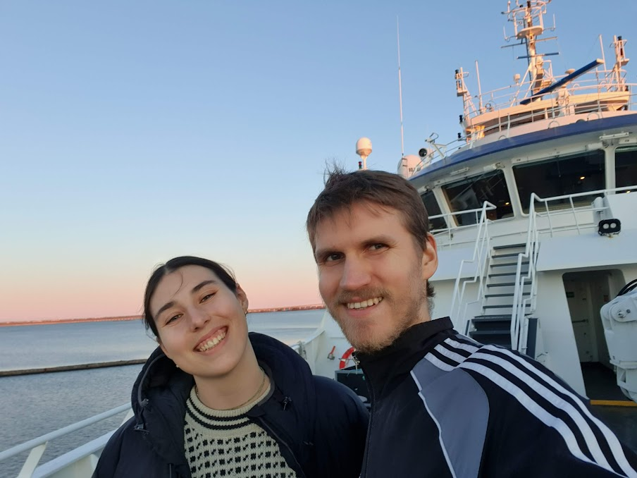



Acknowledgements
Maliheh Mehrshad
Stefan Bertilsson
Bengt Karlsson, Anders Torstensson et al.
Agneta Andersson, Sonia Brugel
Funding:
Anders Andersson
Luis Fernando Delgado
Emma Bell
Karin Garefelt
Meike Latz

Slide 19



Personal website
KTJ microbes
ktjmicrobes.com

